Slide 1
COMPUTER GRAPHICS
Semester 5 – Department of Informatics ITS 2016

Slide 2
Outline
Review Materi Minggu 1: Definisi dan Aplikasi Grafika, Sejarah Grafika
Gambar Fisik dan Sintetik
Sistem Penggambilan Gambar
Model Kamera Sintetik
Sistem Grafika
Piksel dan Frame Buffer
CPU dan GPU
Programmer’s Interface
Arsitektur Sistem Grafika
Programmable Pipeline
Karakteristik Performa
Programming in OpenGL 1: Background

Slide 3
Review: Image Formation
In computer graphics, we form images which are generally two dimensional using a process analogous to how images are formed by physical imaging systems
Cameras
Microscopes
Telescopes
Human visual system

Slide 4
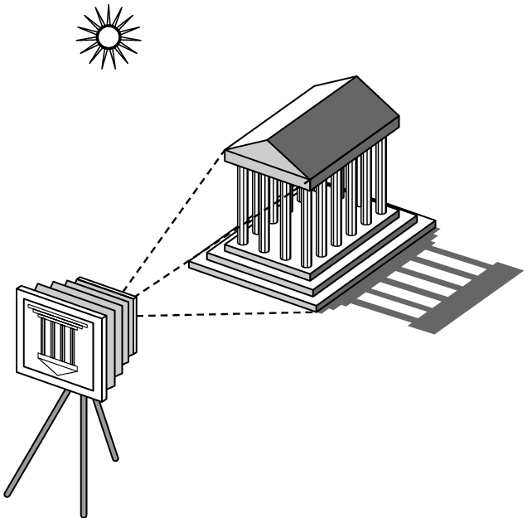
Review: Elements of Image Formation
Objects
Viewer
Light source(s)
Attributes that govern how light interacts with the materials in the scene
Note the independence of the objects, the viewer, and the light source(s)

Slide 5
Review: Light
Light is the part of the electromagnetic spectrum that causes a reaction in our visual systems
Generally these are wavelengths in the range of about 350-750 nm (nanometers)
Long wavelengths appear as reds and short wavelengths as blues

Slide 6
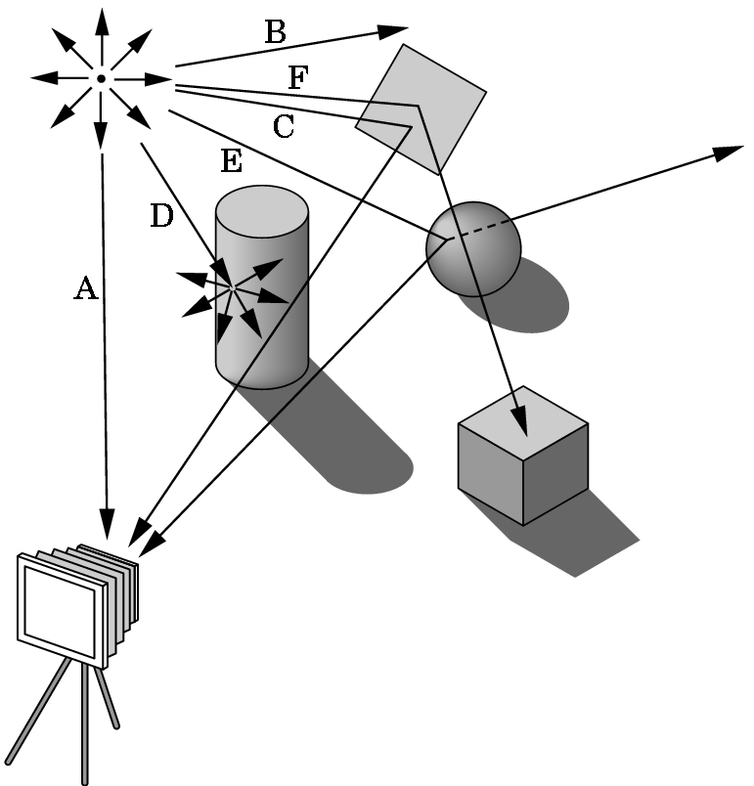
Review: Ray Tracing
One way to form an image is to
follow rays of light from a
point source finding which
rays enter the lens of the
camera. However, each
ray of light may have
multiple interactions with objects
before being absorbed or going to infinity.

Slide 7
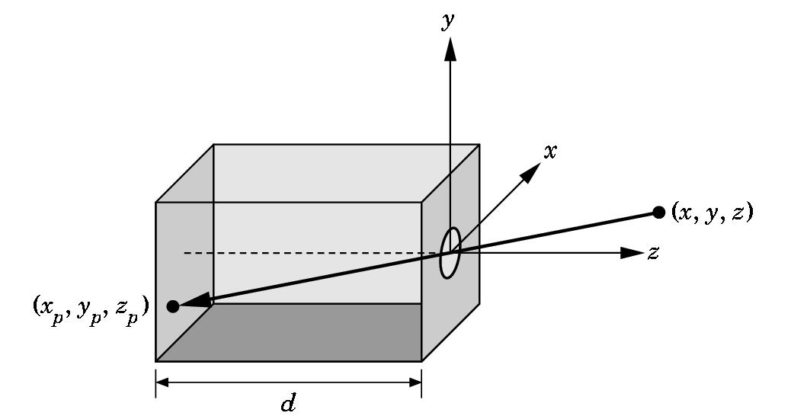
Review: Pinhole Camera
Use trigonometry to find projection of point at (x,y,z)
x_{p}= -x/z/d
y_{p}= -y/z/d
z_{p}= d
The point (x_{p}, y_{p}, −d) is called the projection of the point (x, y, z).

Slide 8
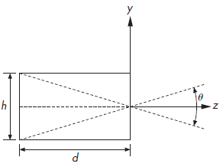
Angle of view
The field, or angle, of view of our camera is the angle made by the largest object that our camera can image on its film plane.

Slide 9
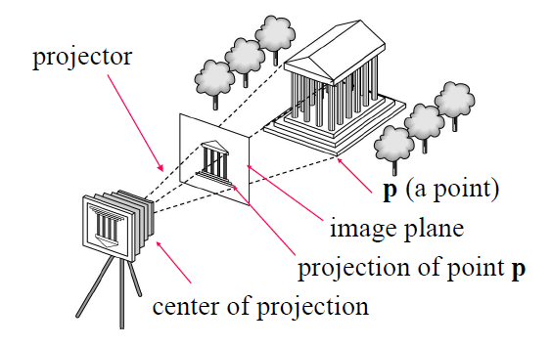
Review: Synthetic Camera Model

Slide 10
Review: Synthetic Camera Model
The specification of the objects is independent of the specification of the viewer.
The image is computed using simple geometric calculations
Another plane is drawn in front of the lens
The image of a point on the object on the virtual image plane (called the projection plane) is founded by drawing a line, called a projector, from the point to the center of the lens, or the center of projection (COP).

Slide 11
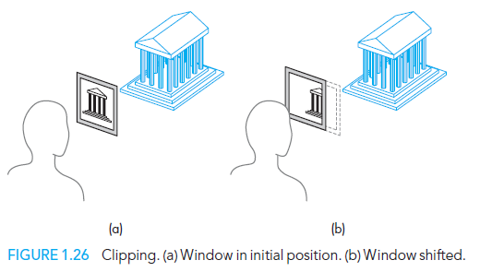
Review: Synthetic Camera Model
A clipping rectangle, or clipping window, is placed in the projection plane.
This rectangle acts as a window, through which a viewer sees the world.

Slide 12
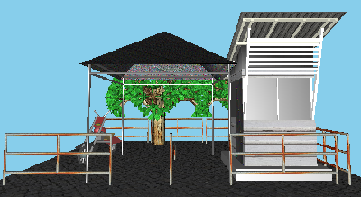
Session 1: Graphics System

Slide 13
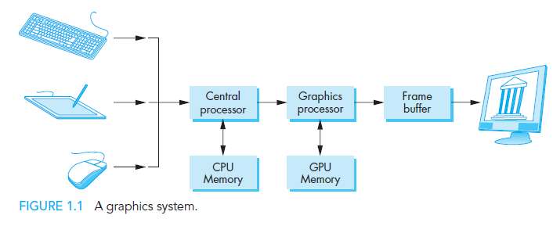
Graphics System
Graphics System
Programmer’s Interface
Graphics System Architecture
Programmable Pipeline
Performance Characteristic

Slide 14
Pixels and Frame Buffer
Graphics System
Programmer’s Interface
Graphics System Architecture
Programmable Pipeline
Performance Characteristic
What defines images?
Array or raster of pixels
What defines pixels?
A location in the image

Slide 15
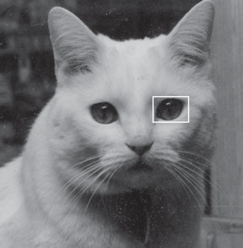
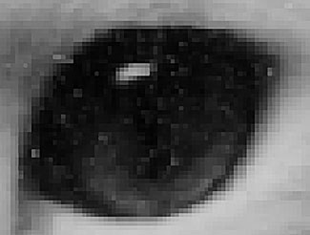
Piksel dan Frame Buffer
Graphics System
Programmer’s Interface
Graphics System Architecture
Programmable Pipeline
Performance Characteristic

Slide 16
Piksel dan Frame Buffer
Graphics System
Programmer’s Interface
Graphics System Architecture
Programmable Pipeline
Performance Characteristic
What is a frame buffer?
A part of memory that stores pixels
What is frame buffer resolution?
The number of pixels in the frame buffer
What is the depth, or precision, of the frame buffer?
The number of bits that are used for each pixel
How many color a 1-bit-deep frame buffer allows?
How many color a 8-bit-deep frame buffer allows?

Slide 17
Piksel dan Frame Buffer
Graphics System
Programmer’s Interface
Graphics System Architecture
Programmable Pipeline
Performance Characteristic
In full-color systems, there are 24 (or more) bits per pixel.
Also known as true-color systems, or RGB-color systems
High dynamic range (HDR) systems use 12 or more bits for each color component.
In a very simple system, the frame buffer holds only the colored pixels.
In most systems, the frame buffer holds far more information, such as depth information.
In these systems, the frame buffer comprises multiple buffers, one or more of which are color buffers that hold the colored pixels that are displayed.
For now, we can use the terms frame buffer and color buffer synonymously.

Slide 18
CPU dan GPU
Graphics System
Programmer’s Interface
Graphics System Architecture
Programmable Pipeline
Performance Characteristic
In a simple system, there may be only one processor, the central processing unit (CPU), which must do both the normal processing and the graphical processing.
The graphical processing is to take specifications of graphical primitives and to assign values to the pixels in the frame buffer that best represent these entities.
The conversion of geometric entities to pixel colors and locations in the frame buffer is known as rasterization, or scan conversion.
In early graphics systems, the frame buffer was part of the standard memory that could be directly addressed by the CPU.
Today, all graphics systems are characterized by graphics processing units (GPUs), custom-tailored to carry out specific graphics functions.
The GPU can be either on the mother board of the system or on a graphics card.
The frame buffer is accessed through the GPU and usually is on the same circuit board as the GPU.

Slide 19
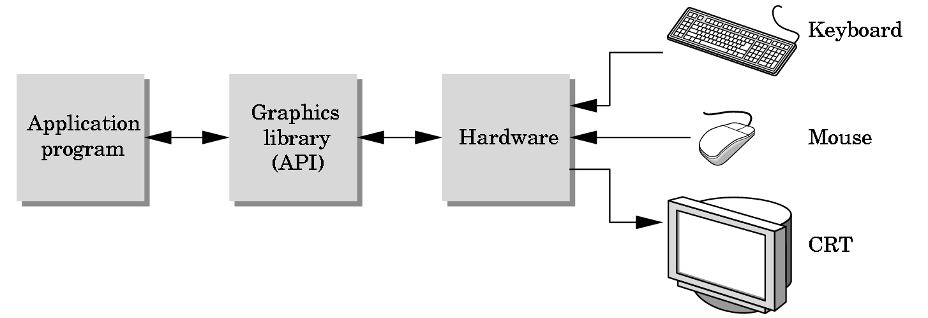
The Programmer’s Interface
Graphics System
Programmer’s Interface
Graphics System Architecture
Programmable Pipeline
Performance Characteristic
Programmer sees the graphics system through a software interface: the Application Programmer Interface (API)

Slide 20
API Contents
Graphics System
Programmer’s Interface
Graphics System Architecture
Programmable Pipeline
Performance Characteristic
Functions that specify what we need to form an image
Objects
Viewer
Light Source(s)
Materials
Other information
Input from devices such as mouse and keyboard
Capabilities of system

Slide 21
Object Specification
Graphics System
Programmer’s Interface
Graphics System Architecture
Programmable Pipeline
Performance Characteristic
Most APIs support a limited set of primitives including
Points (0D object)
Line segments (1D objects)
Polygons (2D objects)
Some curves and surfaces
Quadrics
Parametric polynomials
All are defined through locations in space or vertices

Slide 22
Example (old style)
type of object
location of vertex
glBegin(GL_POLYGON)
glVertex3f(0.0, 0.0, 0.0);
glVertex3f(0.0, 1.0, 0.0);
glVertex3f(0.0, 0.0, 1.0);
glEnd( );
end of object definition

Slide 23
Example (GPU based)
Put geometric data in an array
vec3 points[3];
points[0] = vec3(0.0, 0.0, 0.0);
points[1] = vec3(0.0, 1.0, 0.0);
points[2] = vec3(0.0, 0.0, 1.0);
Send array to GPU
Tell GPU to render as triangle

Slide 24
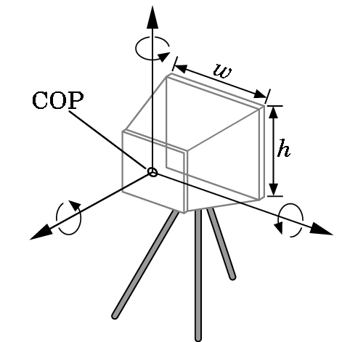
Camera Specification
Six degrees of freedom
Position of center of lens
Orientation
The focal length of the lens: determines the size of the image on the film plane or, the portion of the world the camera sees
Film size
Orientation of film plane

Slide 25
Lights and Materials
Types of lights
Point sources vs distributed sources
Spot lights
Near and far sources
Color properties
Material properties
Absorption: color properties
Scattering
Diffuse
Specular

Slide 26

Pipeline Architecture
Graphics System
Programmer’s Interface
Graphics System Architecture
Programmable Pipeline
Performance Characteristic
We use pipeline architecture when we will do the same operation on many data sets, just like in computer graphics, large sets of vertices and pixels are processed in the same manner.
Four major steps in the imaging process
Vertex processing
Clipping and primitive assembly
Rasterization
Fragment processing

Slide 27
Vertex Processing
Graphics System
Programmer’s Interface
Graphics System Architecture
Programmable Pipeline
Performance Characteristic
Each vertex is processed independently.
Two major functions of this block:
to carry out coordinate transformations and
to compute a color for each vertex

Slide 28
Clipping and Primitive Assembly
Graphics System
Programmer’s Interface
Graphics System Architecture
Programmable Pipeline
Performance Characteristic
The projections of objects in a clipping volume appear in the image. Those that are outside do not and are said to be clipped out.
Clipping must be done on a primitive-by-primitive basis rather than on a vertex-by-vertex basis. Thus, we must assemble sets of vertices into primitives, such as line segments and polygons, before clipping can take place.
So, what is the output of this block?

Slide 29
Rasterization
Graphics System
Programmer’s Interface
Graphics System Architecture
Programmable Pipeline
Performance Characteristic
The primitives that emerge from the clipper are still represented in terms of their vertices and must be converted to pixels in the frame buffer.
For example, if three vertices specify a triangle with a solid color, the rasterizer must determine which pixels in the frame buffer are inside the polygon.
The output of the rasterizer is a set of fragments (potential pixels that carries with it information) for each primitive.

Slide 30
Fragment Processing
Graphics System
Programmer’s Interface
Graphics System Architecture
Programmable Pipeline
Performance Characteristic
It takes in the fragments generated by the rasterizer and updates the pixels in the frame buffer.
If the application generated three-dimensional data, some fragments may not be visible because the surfaces that they define are behind other surfaces.
The color of a fragment may be altered by texture mapping or bump mapping.
The color of the pixel that corresponds to a fragment can also be read from the frame buffer and blended with the fragment’s color to create translucent effects.

Slide 31
Pipeline Architecture
Graphics System
Programmer’s Interface
Graphics System Architecture
Programmable Pipeline
Performance Characteristic
Selain pipeline, dikenal pula metode lain dalam mengimplementasikan grafika komputer, seperti ray tracing, radiosity, atau photon mapping.
Kelebihan arsitektur pipeline dibandingkan metode yang lain:
Program aplikasinya dan program GPUnya mudah
Graphics cards melengkapi GPUnya dengan arsitektur pipeline.
Sesuai untuk aplikasi real time/interaktif seperti game, CAD
Kekurangan arsitektur pipeline dibandingkan metode yang lain:
Gambar yang dihasilkan kurang realistis karena tidak memperhitungkan global lighting
Kurang sesuai untuk aplikasi dengan resolusi dan efek realistis yang tinggi, seperti film animasi

Slide 32
Pipeline Architecture
Graphics System
Programmer’s Interface
Graphics System Architecture
Programmable Pipeline
Performance Characteristic
Awalnya berisi fixed functionality
Program aplikasi dapat mengeset banyak parameter fungsi, tetapi operasi dasar yang terdapat didalam pipeline tetap (tidak dapat diubah).
Saat ini baik vertex maupun fragment processor dapat diubah fungsi/operasi dasarnya oleh program aplikasi.
Efeknya banyak efek yang awalnya tidak dapat dihasilkan secara real-time oleh arsitektur pipeline menjadi bisa, seperti bump mapping (dulunya hanya bisa off-line)

Slide 33
Programmable pipeline
Graphics System
Programmer’s Interface
Graphics System Architecture
Programmable Pipeline
Performance Characteristic
Vertex programs can alter the location or color of each vertex as it flows through the pipeline.
Thus, we can implement a variety of light–material models or create new kinds of projections.
Fragment programs allow us to use textures in new ways and to implement other parts of the pipeline, such as lighting, on a per-fragment basis rather than per vertex.

Slide 34
Performance
Graphics System
Programmer’s Interface
Graphics System Architecture
Programmable Pipeline
Performance Characteristic
Arsitektur pipeline mendominasi pasar graphics cards khususnya jika dibutuhkan aplikasi real-time.
Graphics cards dengan harga murah dapat merender jutaan poligon bertekstur dan berwarna dalam satu detik.
Namun jika dibutuhkan aplikasi dengan hasil lebih realistis, renderer lain lebih unggul walaupun dengan waktu komputasi lebih lama, seperti RenderMan milik Pixar, aplikasi berbasis ray tracing atau radiosity.

Slide 35
Quiz 1

Slide 36
Quiz 1 (30 minutes)
Give three examples of Primitive Geometry Object in Computer Graphics (CG).
What is a vertex/vertices?
How to represent points in CG?
How to represent lines in CG?
How to represent polygon in CG?
What is the dimension of objects, viewer, light sources, and graphics/images?
What is the difference between lines, rays, and line segments?
Describe one method to form images in CG using a physics approach.

Slide 37
Session 2: Programming in OpenGL 1: Background

Slide 38
Objectives
Development of the OpenGL API
OpenGL Architecture
OpenGL as a state machine
OpenGL as a data flow machine
Functions
Types
Formats
Simple program

Slide 39
Early History of APIs
IFIPS (1973) formed two committees to come up with a standard graphics API
Graphical Kernel System (GKS)
2D but contained good workstation model
Core
Both 2D and 3D
GKS adopted as IS0 and later ANSI standard (1980s)
GKS not easily extended to 3D (GKS-3D)
Far behind hardware development

Slide 40
PHIGS and X
Programmers Hierarchical Graphics System (PHIGS)
Arose from CAD community
Database model with retained graphics (structures)
X Window System
DEC/MIT effort
Client-server architecture with graphics
PEX combined the two
Not easy to use (all the defects of each)

Slide 41
SGI and GL
Silicon Graphics Inc (SGI) revolutionized the graphics workstation by implementing the pipeline in hardware (1982)
To access the system, application programmers used a library called GL
With GL, it was relatively simple to program three dimensional interactive applications

Slide 42
OpenGL
The success of GL lead to OpenGL (1992), a platform-independent API that was
Easy to use
Close enough to the hardware to get excellent performance
Focus on rendering: taking the spec of geometric objects and their properties and forming a picture of them with a virtual camera and lights
Omitted windowing and input to avoid window system dependencies

Slide 43
OpenGL Evolution
Originally controlled by an Architectural Review Board (ARB)
Members included SGI, Microsoft, Nvidia, HP, 3DLabs, IBM,…….
Now Kronos Group
Was relatively stable (through version 2.5)
Backward compatible
Evolution reflected new hardware capabilities
3D texture mapping and texture objects
Vertex and fragment programs
Allows platform specific features through extensions

Slide 44
Modern OpenGL
Performance is achieved by using GPU rather than CPU
Control GPU through programs called shaders
Application’s job is to send data to GPU
GPU does all rendering

Slide 45
OpenGL 3.1
Totally shader-based
No default shaders
Each application must provide both a vertex and a fragment shader
No immediate mode
Few state variables
Most 2.5 functions deprecated
Backward compatibility not required

Slide 46
Other Versions
OpenGL ES
Embedded systems
Version 1.0 simplified OpenGL 2.1
Version 2.0 simplified OpenGL 3.1
Shader based
WebGL
Javascript implementation of ES 2.0
Supported on newer browsers
OpenGL 4.1 and 4.2
Add geometry shaders and tessellator

Slide 47
What About Direct X?
Windows only
Advantages
Better control of resources
Access to high level functionality
Disadvantages
New versions not backward compatible
Windows only
Recent advances in shaders are leading to convergence with OpenGL

Slide 48
OpenGL Libraries
OpenGL core library
OpenGL32 on Windows
GL on most unix/linux systems (libGL.a)
OpenGL Utility Library (GLU)
Provides functionality in OpenGL core but avoids having to rewrite code
Links with window system
GLX for X window systems
WGL for Windows
AGL for Macintosh

Slide 49
GLUT
OpenGL Utility Toolkit (GLUT)
Provides functionality common to all window systems
Open a window
Get input from mouse and keyboard
Menus
Event-driven
Code is portable but GLUT lacks the functionality of a good toolkit for a specific platform
No slide bars

Slide 50
freeglut
GLUT was created long ago and has been unchanged
Amazing that it works with OpenGL 3.1
Some functionality can’t work since it requires deprecated functions
freeglut updates GLUT
Added capabilities
Context checking

Slide 51
GLEW
OpenGL Extension Wrangler Library
Makes it easy to access OpenGL extensions available on a particular system
Avoids having to have specific entry points in Windows code
Application needs only to include glew.h and run a glewInit()

Slide 52
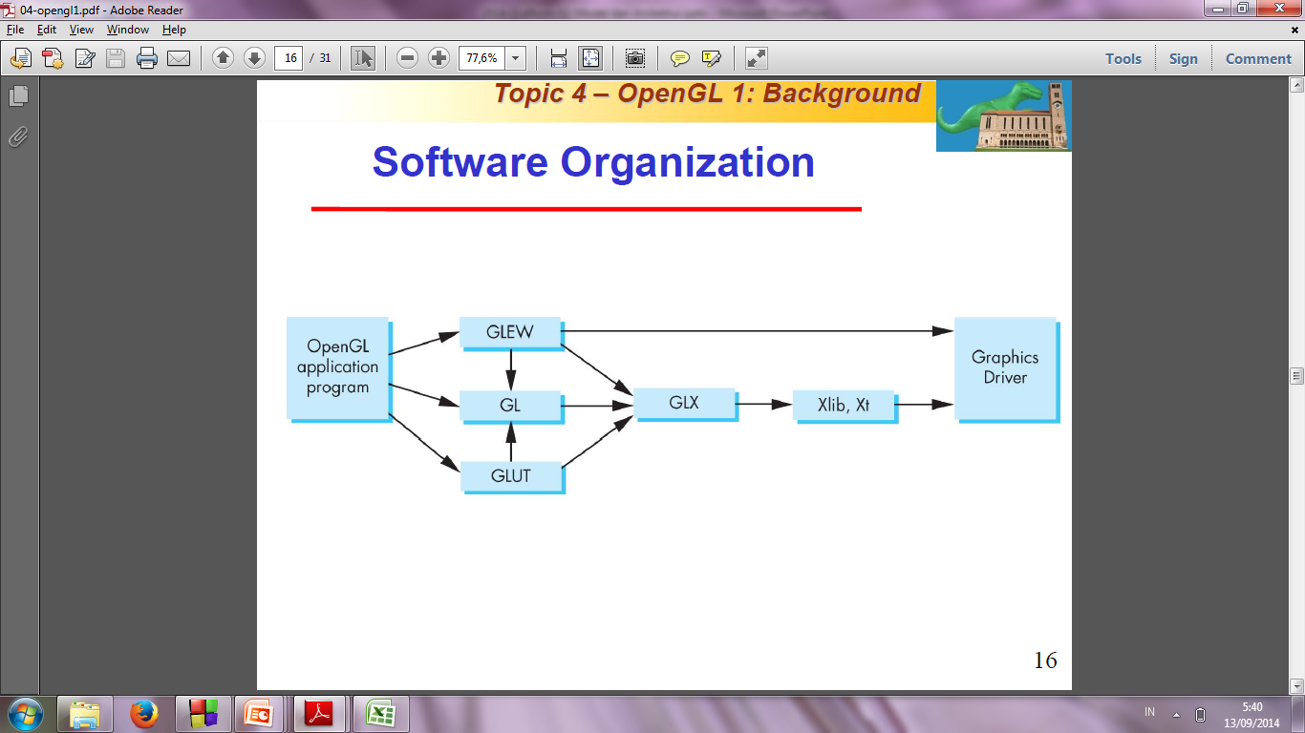
Software Organization

Slide 53
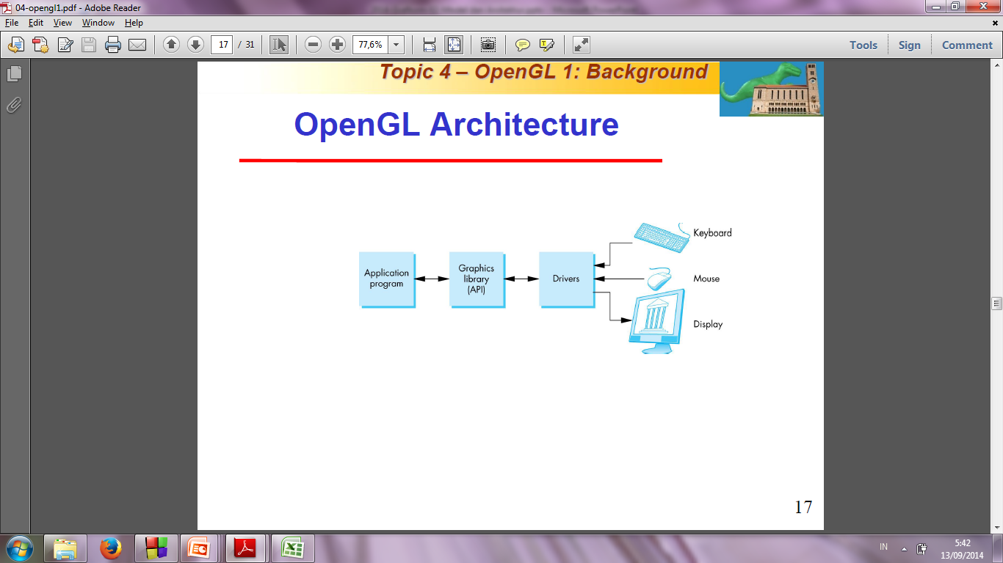
OpenGL Architecture

Slide 54
OpenGL Functions
Primitives
Points
Line Segments
Triangles
Attributes
Transformations
Viewing
Modeling
Control (GLUT)
Input (GLUT)
Query

Slide 55
OpenGL State
OpenGL is a state machine
OpenGL functions are of two types
Primitive generating
Can cause output if primitive is visible
How vertices are processed and appearance of primitive are controlled by the state
State changing
Transformation functions
Attribute functions
Under 3.1 most state variables are defined by the application and sent to the shaders

Slide 56
Lack of Object Orientation
OpenGL is not object oriented so that there are multiple functions for a given logical function
glUniform3f
glUniform2i
glUniform3dv
Underlying storage mode is the same
Easy to create overloaded functions in C++ but issue is efficiency

Slide 57
OpenGL function format
function name
dimensions
glUniform3f(x,y,z)
x,y,z are floats
belongs to GL library
glUniform3fv(p)
p is a pointer to an array

Slide 58
OpenGL #defines
Most constants are defined in the include files gl.h, glu.h and glut.h
Note #include <GL/glut.h> should automatically include the others
Examples
glEnable(GL_DEPTH_TEST)
glClear(GL_COLOR_BUFFER_BIT)
include files also define OpenGL data types: GLfloat, GLdouble,….

Slide 59
OpenGL and GLSL
Shader based OpenGL is based less on a state machine model than a data flow model
Most state variables, attributes and related pre 3.1 OpenGL functions have been deprecated
Action happens in shaders
Job is application is to get data to GPU

Slide 60
GLSL
OpenGL Shading Language
C-like with
Matrix and vector types (2, 3, 4 dimensional)
Overloaded operators
C++ like constructors
Similar to Nvidia’s Cg and Microsoft HLSL
Code sent to shaders as source code
New OpenGL functions to compile, link and get information to shaders

Slide 61
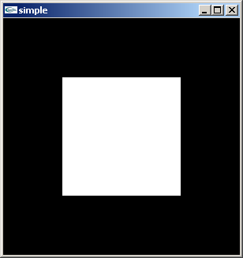
A Simple Program (?)
Generate a square on a solid background

Slide 62
It used to be easy
#include <GL/glut.h>
void mydisplay(){
glClear(GL_COLOR_BUFFER_BIT);
glBegin(GL_QUAD);
glVertex2f(-0.5, -0.5);
glVertex2f(-0.5, 0.5);
glVertex2f(0.5, 0.5);
glVertex2f(0.5, -0.5);
glEnd();
glFlush();
}
int main(int argc, char** argv){
glutCreateWindow("simple");
glutDisplayFunc(mydisplay);
glutMainLoop();
}

Slide 63
What happened
Most OpenGL functions deprecated
Makes heavy use of state variable default values that no longer exist
Viewing
Colors
Window parameters
Next version will make the defaults more explicit
However, processing loop is the same

Slide 64
simple.c
#include <GL/glut.h>
void mydisplay(){
glClear(GL_COLOR_BUFFER_BIT);
// need to fill in this part
// and add in shaders
}
int main(int argc, char** argv){
glutCreateWindow("simple");
glutDisplayFunc(mydisplay);
glutMainLoop();
}

Slide 65
Event Loop
Note that the program defines a display callback function named mydisplay
Every glut program must have a display callback
The display callback is executed whenever OpenGL decides the display must be refreshed, for example when the window is opened
The main function ends with the program entering an event loop

Slide 66
Compilation on Windows
Visual C++
Get glut.h, glut32.lib and glut32.dll from web
Install in same places as corresponding OpenGL files
Create an empty application
Add glut32.lib to project settings (under link tab)
Same for freeglut and GLEW

Slide 67
Review and Exercises
Last week: Follow the instructions in the tutorial
http://wiki.codeblocks.org/index.php?title=Using_FreeGlut_with_Code::Blocks

Slide 68
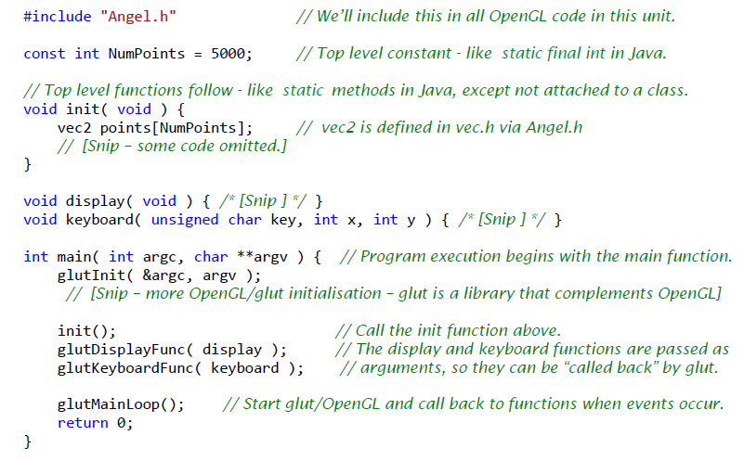
Example1.cpp – program structure

Slide 69
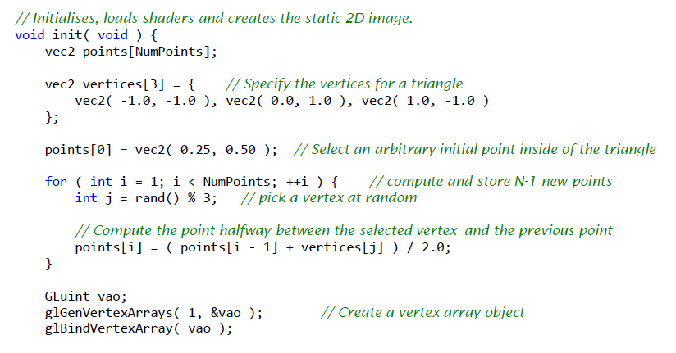
Example1.cpp – init function (1 of 2)

Slide 70
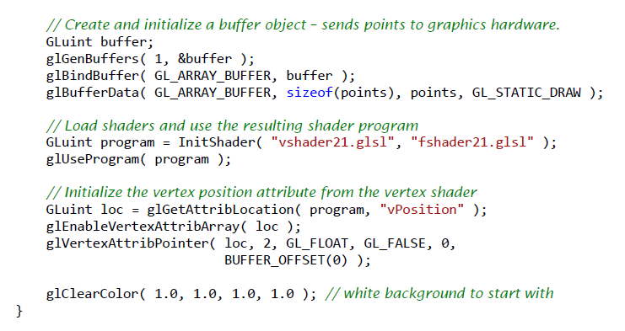
Example1.cpp – init function (2 of 2)

Slide 71
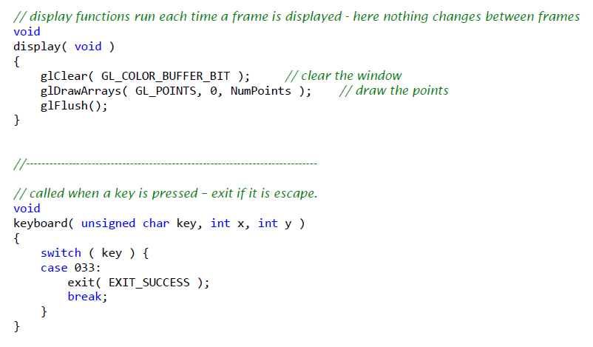
Example1.cpp – display and keyboard

Slide 72
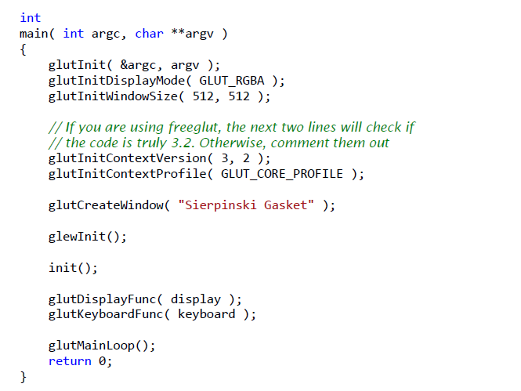
Example1.cpp – main

Slide 73
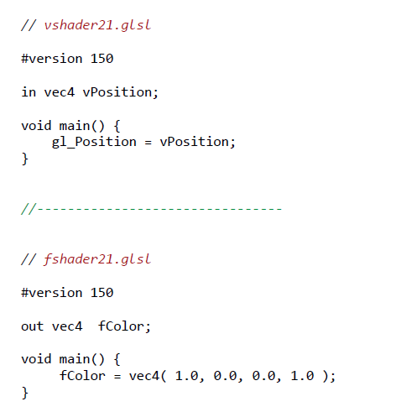
Example1.cpp – GLSL shaders

Slide 74
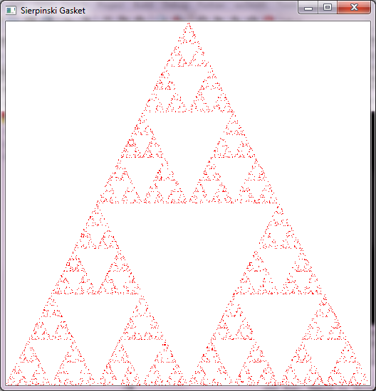

Slide 75
Next Week: Programming in OpenGL 2: Complete Programs
Also Programming in OpenGL 3: Shaders
Read the Textbook Ch. 2 (pp 43 – 56)

